Slide 1

PYTHON EXPLORATORY DATA ANALYSIS
Is the United States economy overheating?
J. Mehdi

Slide 2
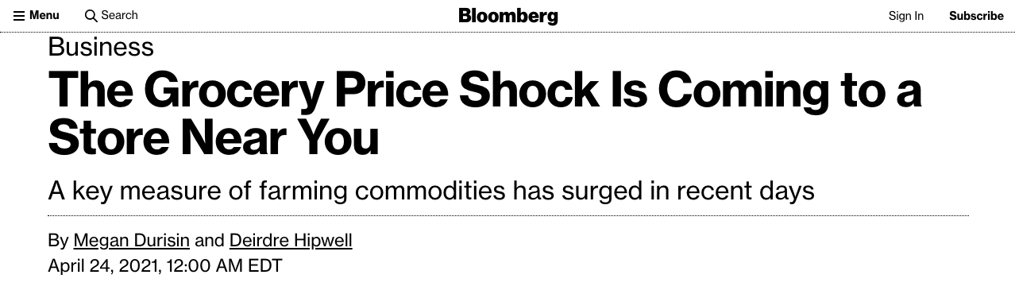
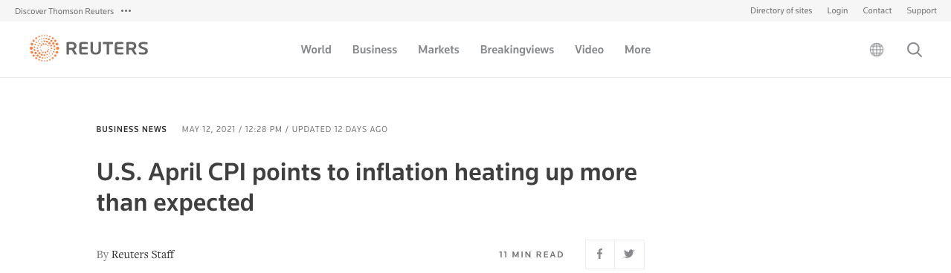
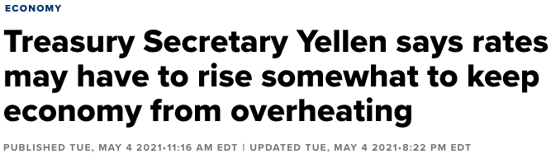
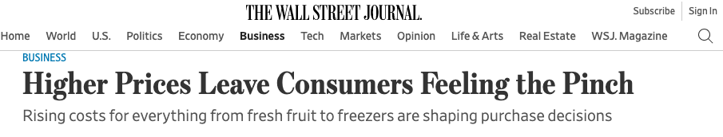
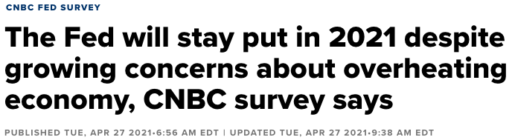
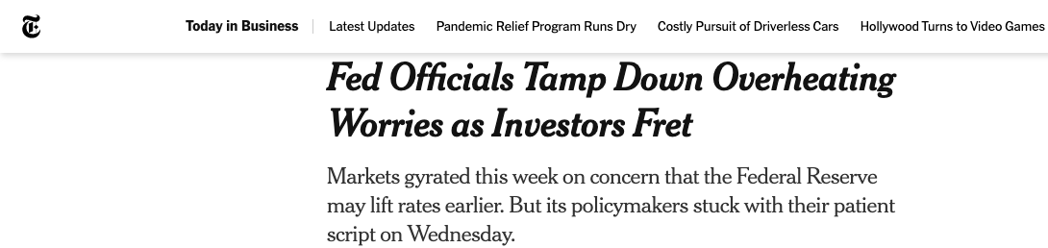
The Noise

Slide 3
Who Cares?
(Rhetorical)
1. Regulators
2. D.C. (Policy Makers)
3. Wall Street (Investors)
4. Producers
5. Consumers
Notes:
Overheating of an economy occurs when its productive capacity is unable to keep pace with growing aggregate demand.

Slide 4
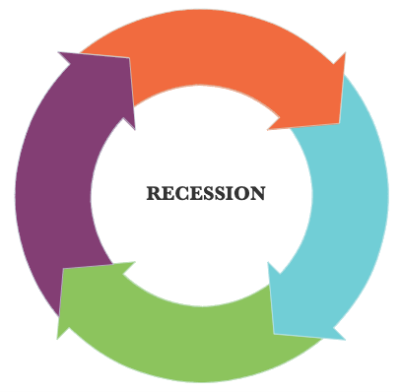
Why Care?
(Cause-Effect)
DEMAND > SUPPLY
DEBT -> CENTRAL BANKS
DEMAND-PULL INFLATION
EXPORTS less COMPETITIVE
Notes:
Overheating of an economy occurs when its productive capacity is unable to keep pace with growing aggregate demand.

Slide 5
Why Care?
(Cause-Effect)
Signs (In order of priority):
Rising Inflation
Unemployment Rate
Housing Prices
Household Debt
… etc.
Notes:
Overheating of an economy occurs when its productive capacity is unable to keep pace with growing aggregate demand.

Slide 6
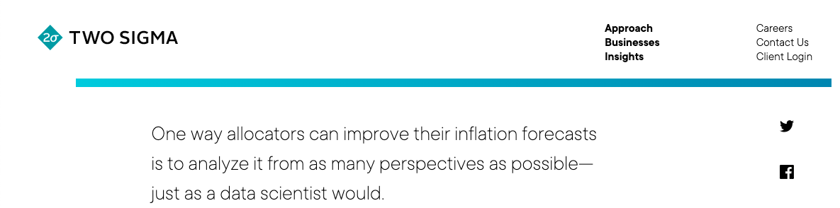
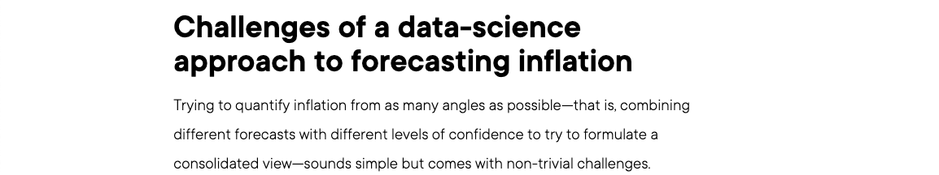
Data Science & Financial Science
Notes:
Overheating of an economy occurs when its productive capacity is unable to keep pace with growing aggregate demand.

Slide 7
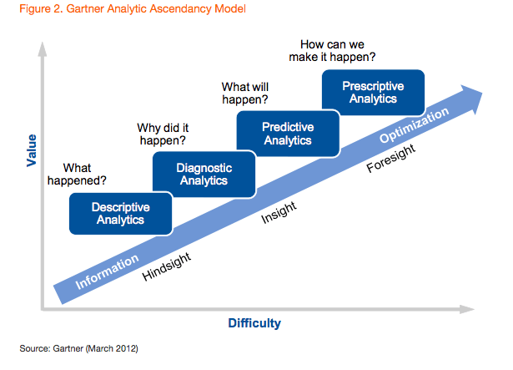
MACRO: The Approach
Notes:
Overheating of an economy occurs when its productive capacity is unable to keep pace with growing aggregate demand.

Slide 8
MICRO: Process & Procedures
Data Acquisition
Data Cleaning
Data Exploration

Slide 9
Tools & Techniques: ACQUISITION
Data was acquired in CSV format from the following sources:
Federal Reserve
a. Personal Consumption and Expenditure Price Index (PCEPI)
b. 10-Year Treasury Bond
Bureau of Labor Statistics
a. Consumer Price Index (CPI)
b. Producer Price Index (PPI)
c. Inflation, consumer prices for the United States
The Economist
Big Mac Index

Slide 10
Tools & Techniques: CLEANING
Missing Data
Dropping Columns in a Data Frame
Concatenating

Slide 11

Tools & Technique: EXPLORATION
Python:
NumPy
SciPy
Trend in a single variable over time, not correlation or causation between multiple variables.
Time-Series

Slide 12
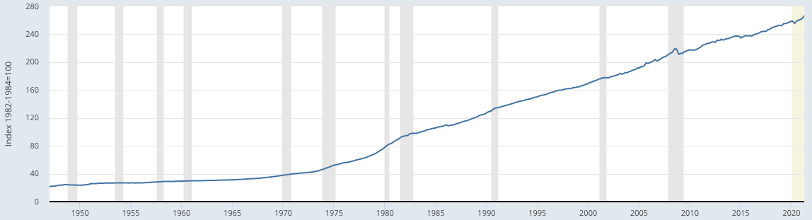
Signal(s): CPI
Consumer Price Index for All Items in U.S. City Average

Slide 13
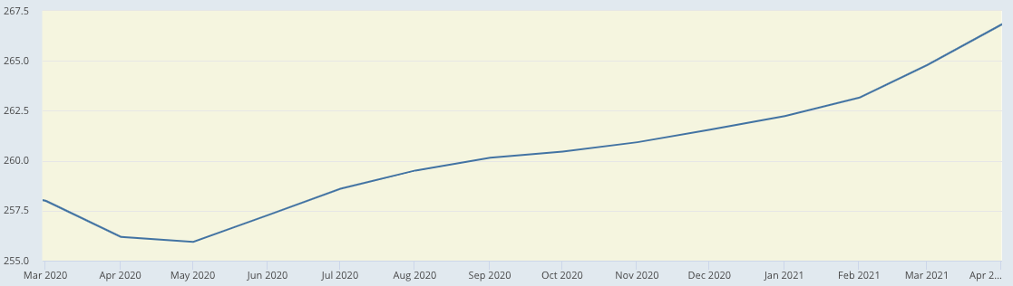
Signal(s): CPI
Consumer Price Index for All Items in U.S. City Average

Slide 14
Signal(s): Big Mac Index
CPI & BIG MAC $ vs. Time
BIG MAC PRICES ($)
INFLATION (CPI)

Slide 15
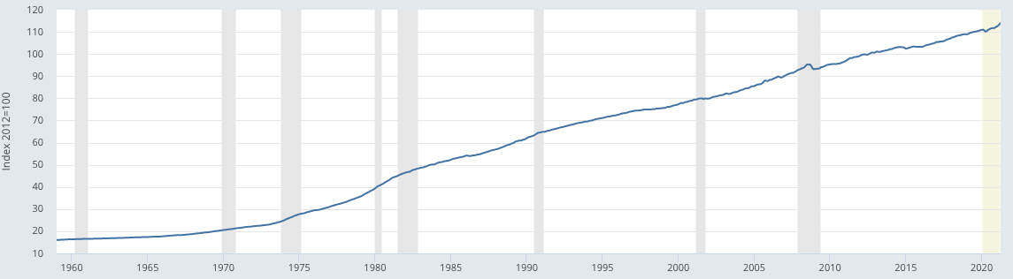
Signal(s): PCEPI
Personal Consumption Expenditures Price Index

Slide 16
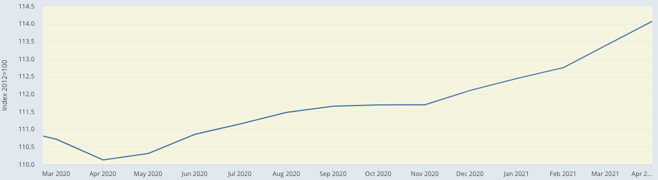
Signal(s): PCEPI
Personal Consumption Expenditures Price Index

Slide 17
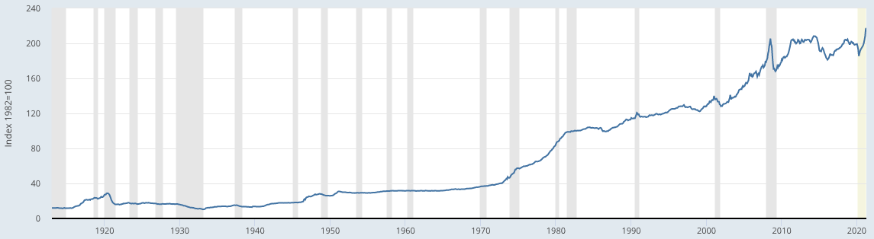
Signal(s): PPI
Producer Price Index All Commodities

Slide 18
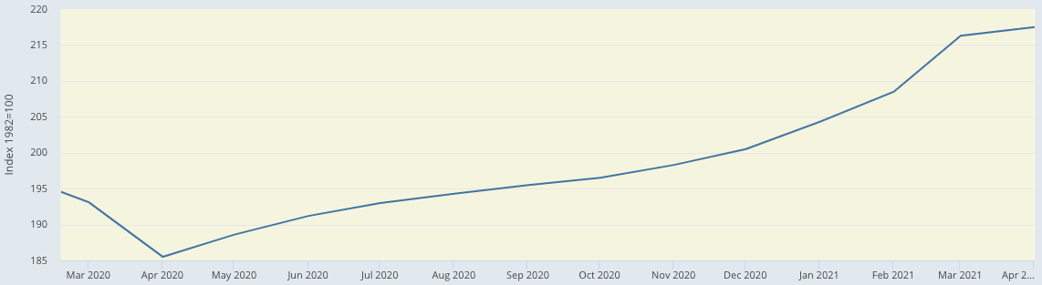
Signal(s): PPI
Producer Price Index All Commodities

Slide 19
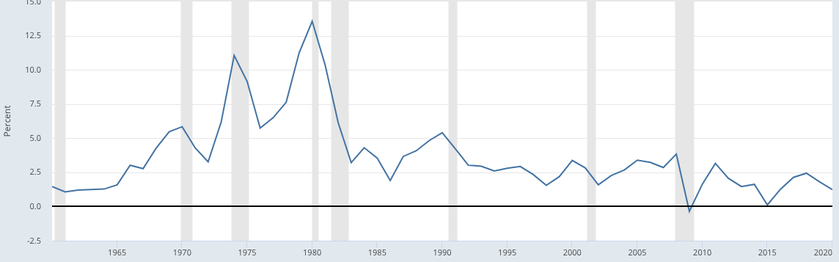

Signal(s): INFLATION
Inflation Rate

Slide 20
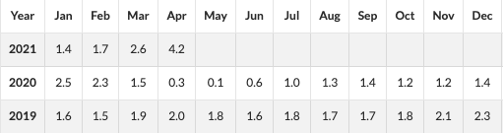
Signal(s): INFLATION
Inflation Rate

Slide 21
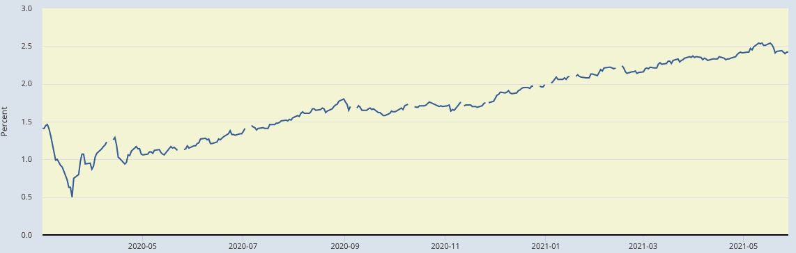
Signal(s): TREASURY BONDS
10-YEAR BREAKEVEN INFLATION RATE

Slide 22
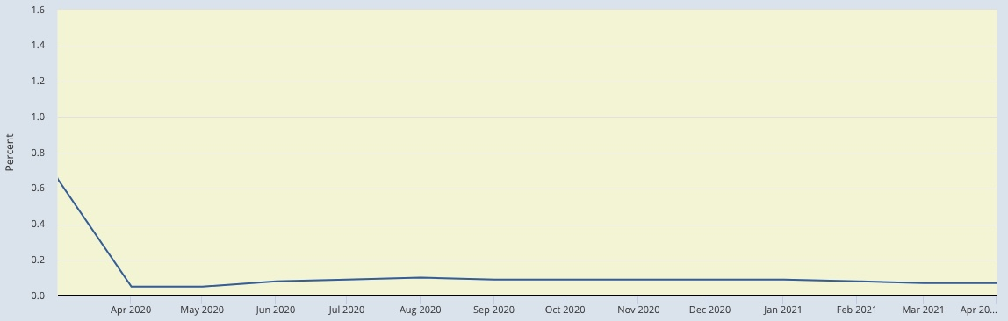
CONCLUSION & RECOMMENDATIONS
Based on analyzing the data and filtering the signal from the noise it can be concluded that:
Flickering, Not Flashing.
MONETARY POLICY: FED FUNDS RATE

Slide 23
FURTHERMORE
Further Study:
Unemployment
a. Data from the Department of Labor
b. Data from the Bureau of Labor Statistics
Housing Prices
a. Zillow
Household Debt
a. OECD

Slide 24
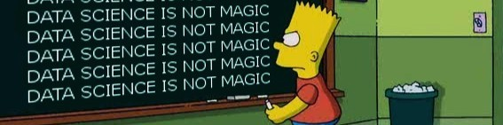
QUESTIONS & CRITIQUES
THANK YOU!

